Slide 1
What is a Physiatrist?

Slide 2
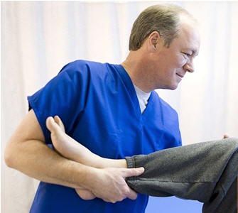
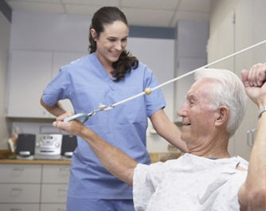
Physiatry: Definition
Physiatry: From Greek physikos (physical) and iatreia (art of healing)
Known as Physical and Rehabilitation Medicine

Slide 3
Historical Perspective
Physical modalities date back to ancient times
Modern medical specialty began to develop during WW I
Coalesced during and after WW II, and the polio epidemic
Addressing need for rehabilitation of injured veterans and polio survivors
Physiatry formally recognized as medical specialty in 1947
Today, over 11,000 board-certified physiatrists nationwide

Slide 4
Physiatry: Myths and Truths
Physiatrists are…
MDs and DOs
able to diagnose and prescribe
located throughout the U.S.
available for in-patient and out-patient care
integral members of the care team
Physiatrists are NOT…
in competition with PCPs
physical therapists (physiotherapists)
chiropractors
psychiatrists

Slide 5
Physiatry: Training
4-year medical school
Residency programs
78* accredited programs listed in the U.S. in 2015
1 year internal medicine prelim, surgical prelim, or transitional year
3 years PM&R training
Fellowships
Fellowship programs allow for sub-specialization
E.g., spinal cord injury, sports medicine, pain
*AAP Residency Training Program Directory (2015) Available at: http://www.physiatry.org/?page=program_directors
Notes:
5
NOTE: AAP Residency Training Program Directory (2000) cites 81 programs; AAPM&R Website cites 79 programs.

Slide 6
Subspecialty/Fellowship Training
Subspecialty fellowships accredited by the ACGME for physical medicine and rehabilitation include:
Hospice and palliative medicine
Neuromuscular medicine
Pain medicine
Pediatric rehabilitation
Spinal cord injury medicine
Sports medicine
Traumatic brain injury

Slide 7
Subspecialty/Fellowship Training
Non-ACGME accredited fellowships available for physical medicine and rehabilitation include:
Cancer rehabilitation
Multiple sclerosis
Neurorehabilitation
Research
Spine rehabilitation/interventional spine

Slide 8
The Physiatric Approach
Guiding principles:
Patient function and quality of life
Integrated care
Combine pharmacological and non-pharmacological modalities
Non-surgical approach to treatment and rehabilitation
Coordinate interdisciplinary treatment team
Work with PCP, specialists, physical and other therapists

Slide 9
Multispecialty Approach
Residency training is unique in its multispecialty process, which allows for a very unique patient care approach
Physiatrists receive formal orthopedic, rheumatologic, musculoskeletal and neurologic training to care for patients in both in-patient and out-patient settings
Physiatrists perform electromyography, musculoskeletal ultrasound and advanced spinal/joint injections
Priority is to avoid surgery while maintaining function

Slide 10
Physiatry: Improving Function
Goal is prevention, diagnosis, and treatment of disorders that may produce temporary or permanent impairment
Restoration of function
Maximize quality of life
“Whole-istic” approach (the whole patient, not just a body part): patient-centered care

Slide 11
Practice Settings: Inpatient
Leads an interdisciplinary team (physical, occupational and/or speech therapist, social worker, psychologist and chaplain)
Oversees the medical component as well prescription of therapeutic modalities
Typically treats spinal cord injury, brain injury (traumatic and non-traumatic), stroke, multiple sclerosis, polio, burn care, and musculoskeletal and pediatric rehabilitation

Slide 12
Practice Settings: Outpatient
Experts at nonsurgical management of conditions including orthopaedic injuries, spine-related pain and dysfunction, occupational injuries and overuse symptoms, neurogenic bowel/bladder, pressure sore management, spasticity management and chronic pain
Typically practice in multidisciplinary groups with other physiatrists, orthopaedic surgeons and/or neurosurgeons

Slide 13
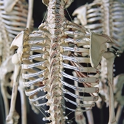
Physiatry: Conditions Treated
Musculoskeletal
Trauma and injuries:
Sports- or work-related injuries, repetitive use disorders (e.g., carpal tunnel syndrome)
Acute and chronic pain syndromes:
Back/neck pain
Diseases
Osteoporosis, arthritis
Other
Rehabilitation following joint reconstruction, amputation

Slide 14
Physiatry: Conditions Treated
Cardiovascular
Cardiac rehabilitation
Vascular diseases
Pulmonary
COPD
Other respiratory dysfunction
Others include:
Rehabilitation for cancer, HIV, pediatrics, geriatrics

Slide 15
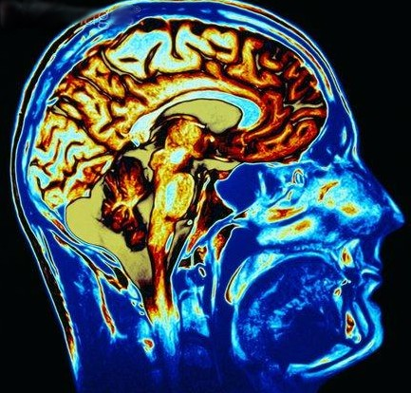
Physiatry: Conditions Treated
Neurologic
Spinal cord injury, traumatic brain injury
Stroke
Multiple sclerosis
Peripheral neuropathy
Movement disorders: Parkinson’s disease, cervical dystonia, and other focal dystonias
Motor neuron disease

Slide 16
The Physiatric Approach to Care
Examples:
Traumatic brain injury: improve cognitive and social functioning and return-to-work issues
Acute disc herniation: maximize function and decrease pain with various injection techniques (including epidurals) and physical therapy, while avoiding surgical intervention
Post-hip replacement: decrease pain and improve functional gait/activities
Sprained ankle: strengthen and improve proprioception

Slide 17
The Physiatric Approach to Care
Examples:
Post MI: optimize cardiopulmonary function
Spinal cord injury: manage spasticity and assess need for appropriate adaptive equipment
Post-stroke: increase mobility and range of motion in patients with spasticity, use focal treatment with botulinum toxin or phenol injection in conjunction with physical/occupational therapy

