Slide 1
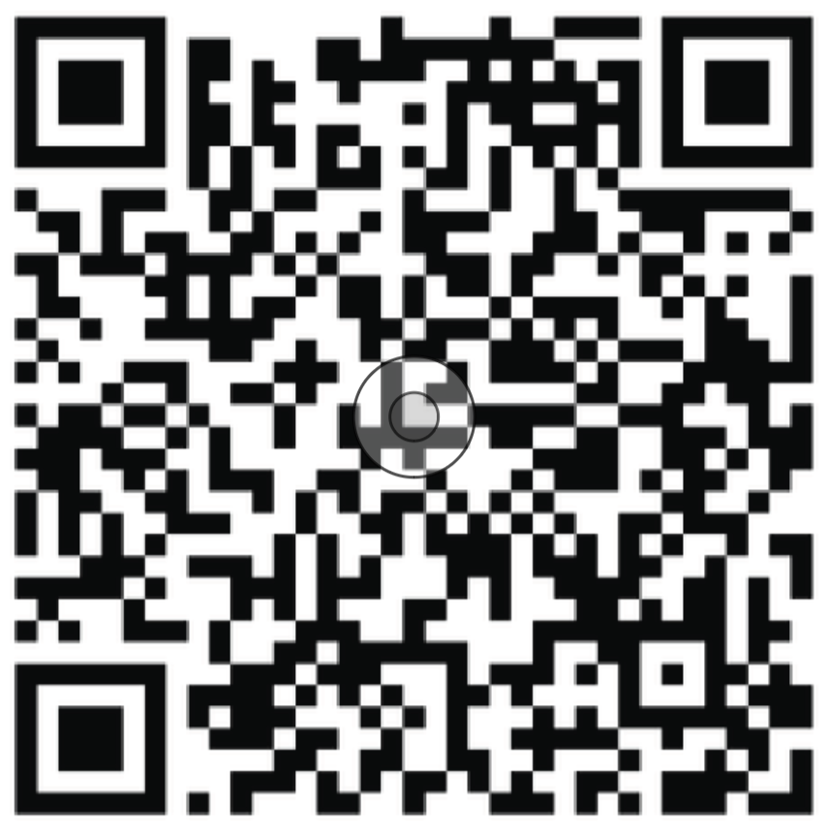
Multidisciplinary Collaborative Guidance on the Assessment and Treatment of Patients with Long COVID: A Compendium Statement
Includes 13 supplementary tables
with recommendations, assessment tools and treatment recommendations
Published in PM&R with open access

