Slide 1
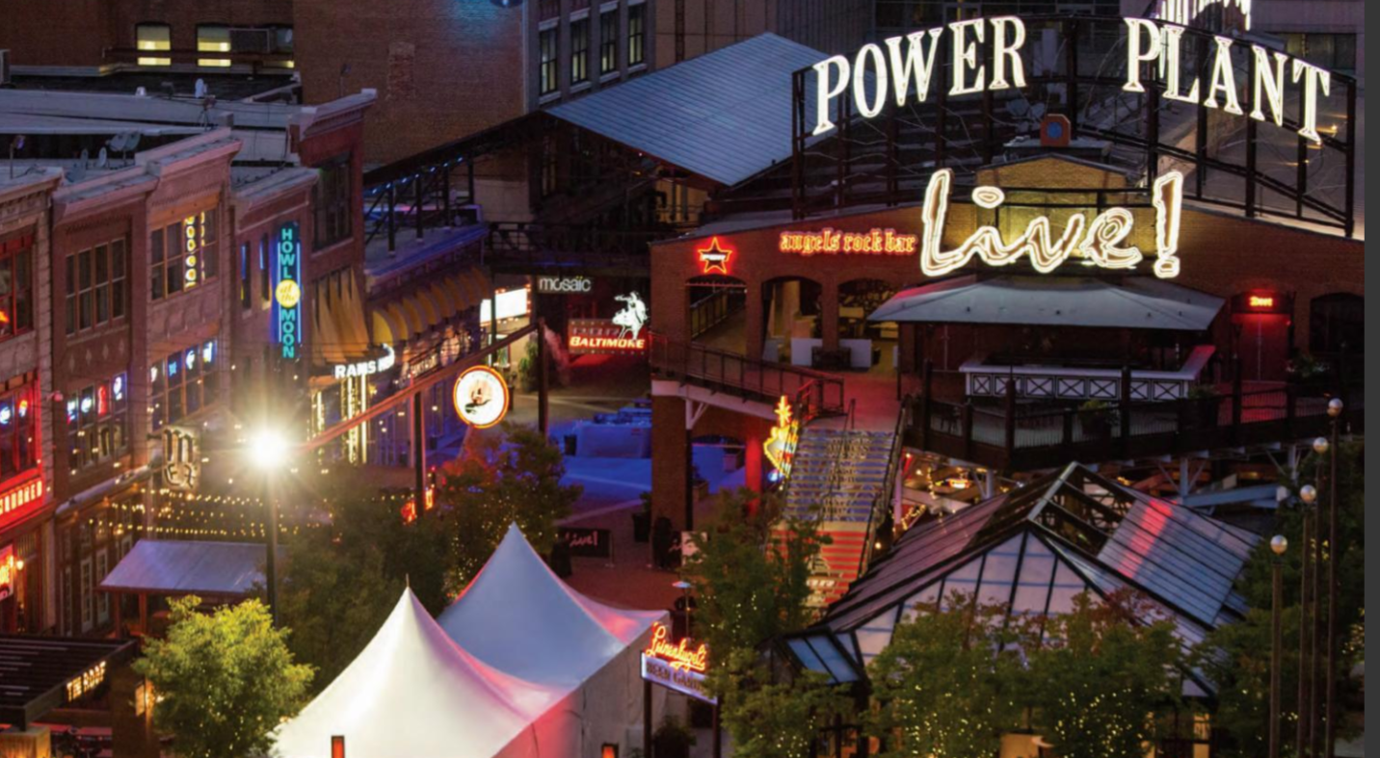
President’s Reception
Friday, October 21, 2022

Slide 2
Power Plant Live
FEATURES
Multiple unique venues
Canopied roof over the Plaza
Stage for LIVE music
Games
Multiple TV screens
Anticipated attendance between 500 and 750 people

Slide 3
Stage Sponsorship Includes: - 8’ x 4’ Banner overlooking stage - 5 table decals inside the venue - Logo and recognition on screens within the venue - Meter Board thanking the sponsors with your logo - Recognition in Mobile App and wherever the President’s Reception is included Two opportunities available Sponsorship fee, each@ $15,000
Your Logo
Your logo

Slide 4
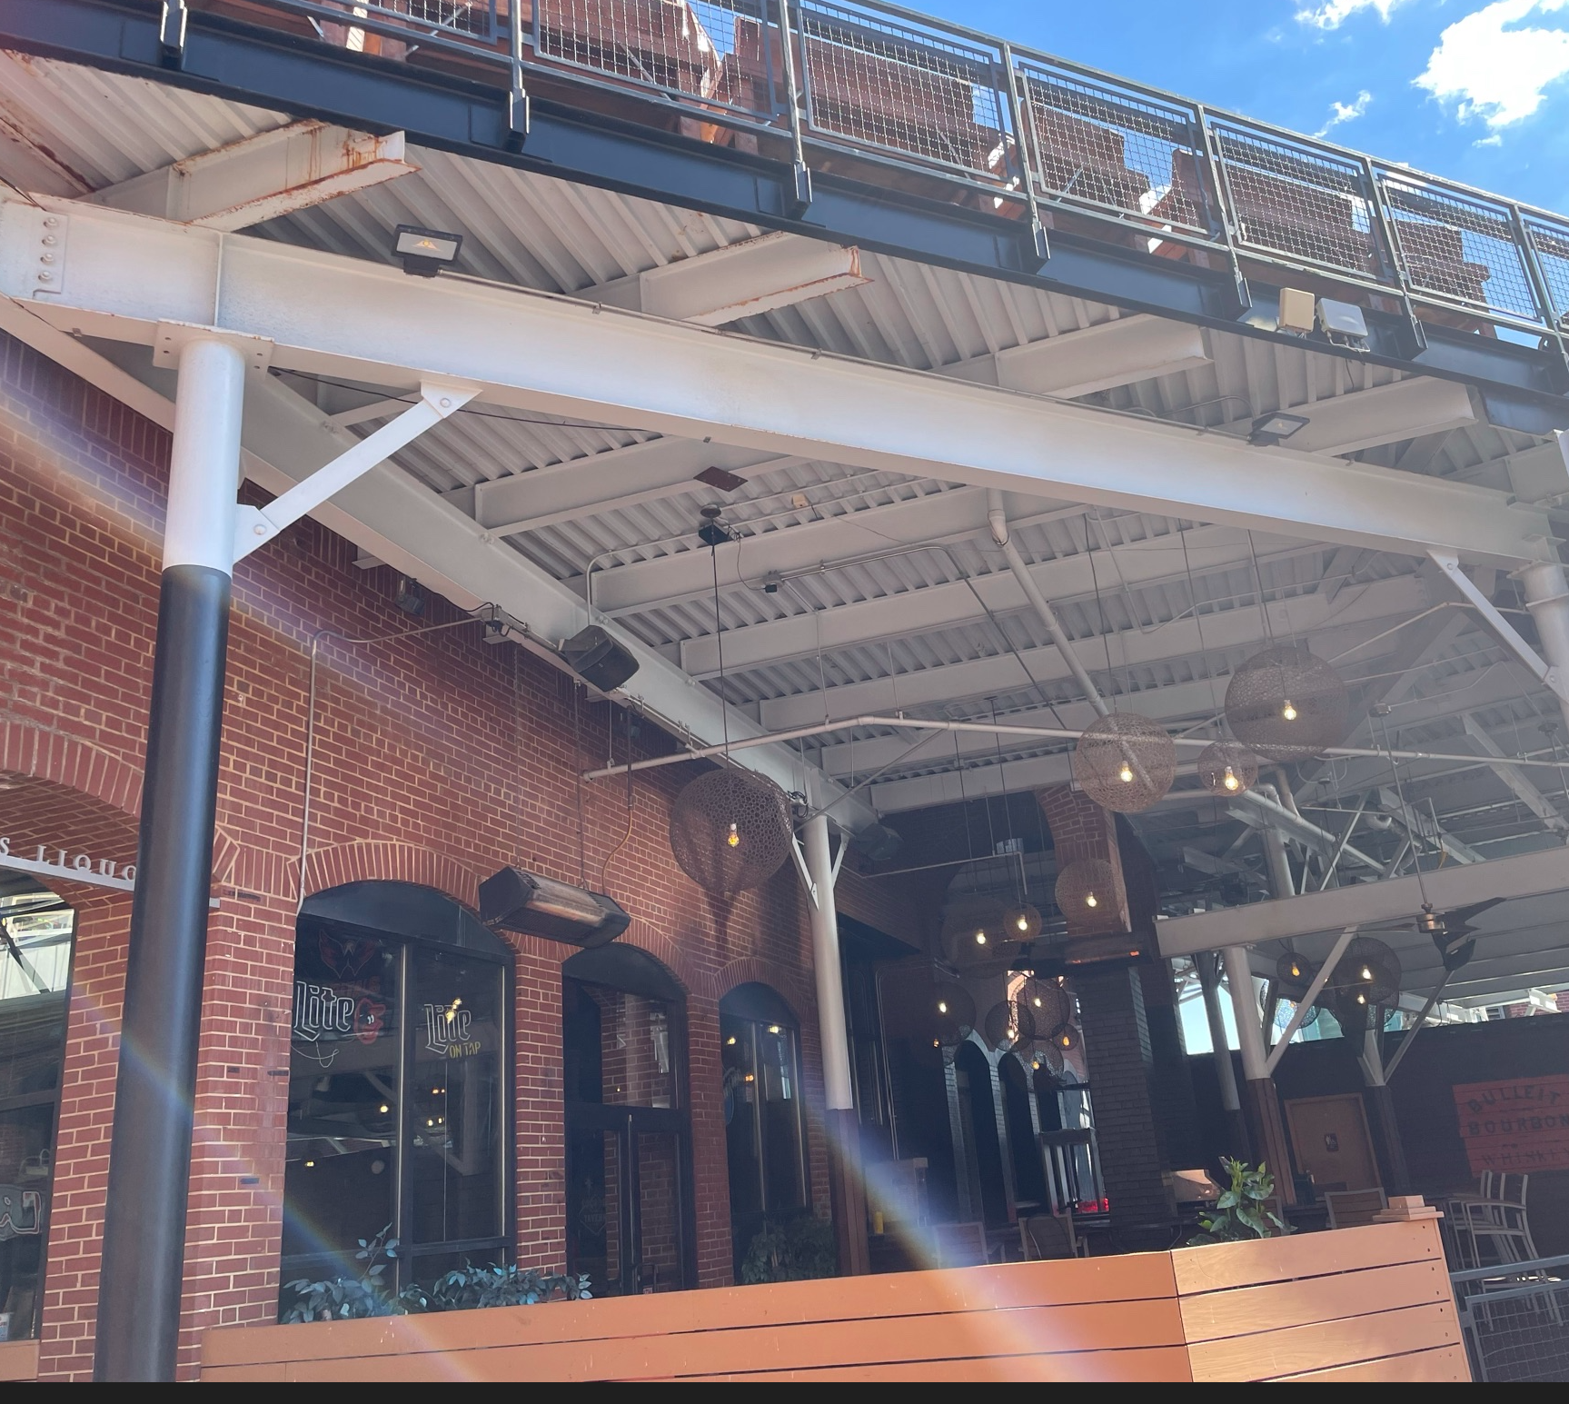
Entrance Sponsor
Your Logo / Message
Banner, 10’ x 5’ hanging at the entrance
Logo and recognition on screens within the venue
Meter Board thanking the sponsors with your logo
Recognition in Mobile App and wherever the President’s Reception is included
Sponsorship Fee: $15,000

Slide 5
Questions, Please Contact Us At:
Lisa Koch: Exhibits and Sponsorships
lkoch@conventusmedia.com
(617) 285-2320
Kathleen Noonan: Exhibits and Sponsorship
knoonan@conventusmedia.com
(781) 375-8584
Sharon Popielewski: Business and Resource Development/ Corporate Support
Spopielewski@aapmr.org
(847) 737-6048

