Slide 1
The Quality Payment Program: Reporting as an Inpatient Physiatrist
AAPM&R Webinar
August 24, 2017
Bob Jasak, JD
VP, Coverage and Payment Policy
Hart Health Strategies, Inc.

Slide 2
Physician Payment Updates:
2019 – 2026+
2019 Base Update of 0.5%
* Base update 0% from 2020-2025; 2026: MIPS: 0.25% update;
APMs: 0.75% update
Merit Based Incentive Payment System
(MIPS)
Advanced
Alternative Payment Models

Slide 3
Merit-based Incentive Payment (MIPS) Overview

Slide 4
MIPS: Exclusions
While more than 40% of clinicians billing under the Medicare PFS will be eligible for exclusion from MIPS, CMS estimates that 33.8% of physical medicine practices will be excluded from MIPS in 2017
Specialty | Newly- Enrolled | QP Status | Low-Volume | Total Exclusions | Total Inclusions
Physical Medicine | 501 (5.1%) | 79 (0.8%) | 2,756 (28.0%) | 3,336 (33.8%) | 6,520 (66.2%)

Slide 5
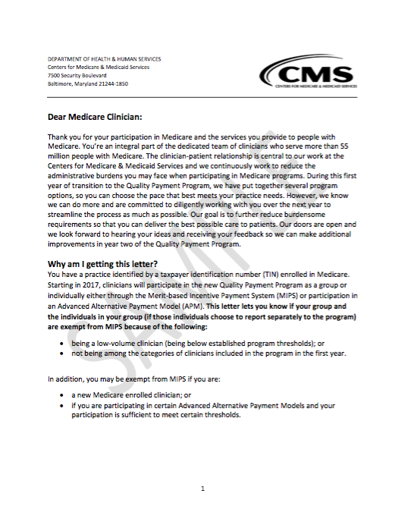
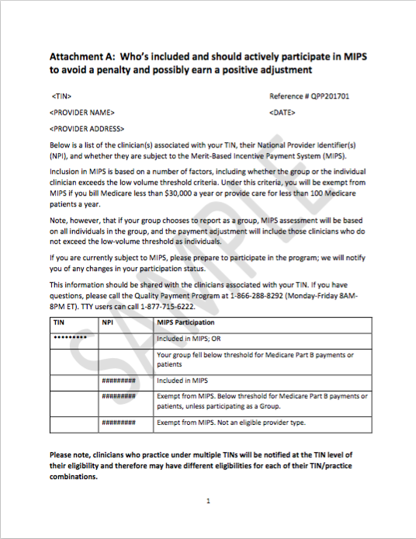
MIPS Participation Letter
Notes:
The MIPS Participation Letter indicated whether a TIN or NPI is exempt from the program whereas the more recently announced Special Status Determinations indicate if you are eligible for special reporting/scoring accommodations under MIPS (although the online lookup tool should now include everything)

Slide 6
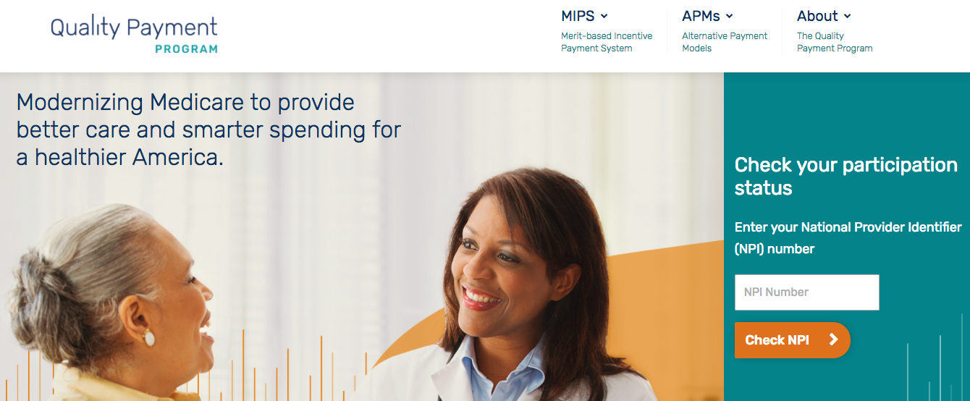
MIPS NPI Look-up: qpp.cms.gov
Notes:
The MIPS Participation Letter indicated whether a TIN or NPI is exempt from the program whereas the more recently announced Special Status Determinations indicate if you are eligible for special reporting/scoring accommodations under MIPS (although the online lookup tool should now include everything)

Slide 7
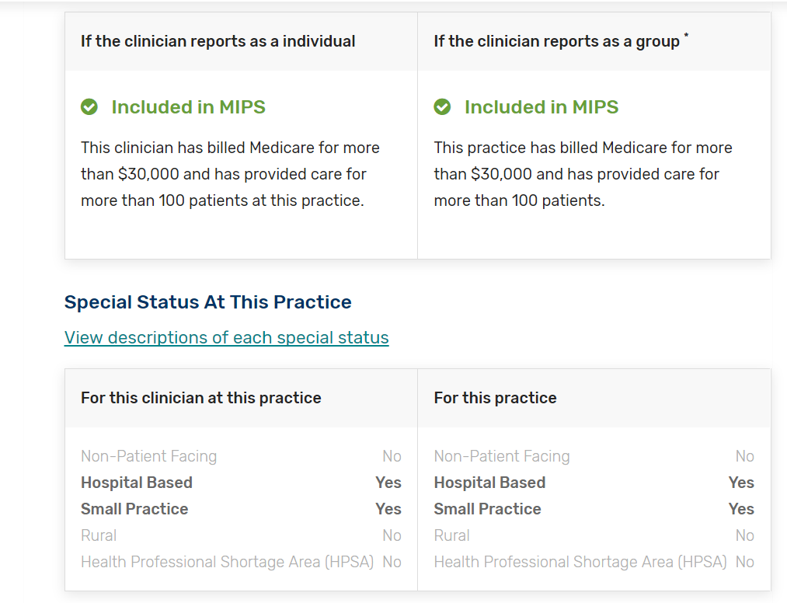
MIPS NPI Look-up: qpp.cms.gov
Notes:
The MIPS Participation Letter indicated whether a TIN or NPI is exempt from the program whereas the more recently announced Special Status Determinations indicate if you are eligible for special reporting/scoring accommodations under MIPS (although the online lookup tool should now include everything)

Slide 8
MIPS: Merit-Based Incentive Payment System
Quality
Advancing Care Information
Cost
Improvement Activities
MIPS Payment Update
2019 | 2020 | 2021 | 2022 | 2023 | 2024 | 2025 …
(+/-) 4% | (+/-) 5% | (+/-) 7% | (+/-) 9%

Slide 9
MIPS Performance Category Weighting
Performance Category | Category Weight
 | Performance Year 2017 | Proposed Perf. Year 2018 | Performance Year 2019-
Quality | 60% | 60% | 30%
Advancing Care Information | 25% | 25% | 25%
Cost | 0% | 0% | 30%
Improvement Activities | 15% | 15% | 15%

Slide 10
Using PQRS Reporting Data as an Indicator of MIPS Participation
Participation % by Specialty (2015)
1. Pathology | 89.4%
2. Radiology | 86.7%
3. Anesthesiology | 84.3%
4. Interventional Radiology | 84.1%
5 (tie). Oncology/Hematology | 84.0%
5 (tie). Emergency Medicine | 84.0%
7. Thoracic/Cardiac Surgery | 82.8%
8. Cardiology | 82.5%
9. Radiation Oncology | 81.0%
10. Rheumatology | 80.9%
All MDs/DOs | 75.0%
35. Physical Medicine | 62.7%
% Penalized by Specialty (2017)
1. Oncology/Hematology | 18.6%
2. Cardiology | 20.2%
3. Pathology | 20.2%
4. Thoracic/Cardiac Surgery | 20.6%
5. Radiation Oncology | 21.6%
6. Rheumatology | 21.9%
7. Radiology | 22.2%
8. Nuclear Medicine | 22.5%
9. Endocrinology | 23.8%
10. Colon/Rectal Surgery | 24.4%
All MDs/DOs | 31.6%
35. Physical Medicine | 43.8%

Slide 11
Physical Medicine PQRS Reporting in 2015

Slide 12
Specifications include eligibility to report on a measure by inclusionary and exclusionary criteria including anchoring to the CPT code billed
Many PQRS and MIPS measures are structured around services provided in the office setting
MIPS continues to set a general presumption that eligible clinicians should be able to report on at least 6 quality measures
Must also report on one outcome or high priority measure if no outcome measure is available
The Inpatient Consult Conundrum

Slide 13
2014
Measure Name | Outcome or High Priority?
1. Documentation of Current Medications in the Medical Record (PQRS #130) | X
2. Body Mass Index (BMI) Screening and Follow-Up (PQRS #128)
3. Pain Assessment and Follow-Up (PQRS #131) | X
4. Tobacco Use: Screening and Cessation Intervention (PQRS #226)
5. Falls: Risk Assessment (PQRS #154) | X
Top 5 Most Reported Measures in
Physical Medicine
2015
Measure Name | Outcome or High Priority?
1. Documentation of Current Medications in the Medical Record (PQRS #130) | X
2. Body Mass Index (BMI) Screening and Follow-Up (PQRS #128)
3. Tobacco Use: Screening and Cessation Intervention (PQRS #226)
4. Pain Assessment and Follow-Up (PQRS #131) | X
5. Falls: Risk Assessment (PQRS #154) | X

Slide 14
 | Measure | Reporting Option
Outcome or High Priority? |  | Claims | EHR | Registry
X | QPP #001: Diabetes: Hemoglobin A1c (HbA1c) Poor Control (>9%) | X | X | X
X | QPP #047: Advance Care Plan | X |  | X
X | QPP #130: Documentation of Current Medications in the Medical Record | X | X | X
X | QPP #407: Appropriate Treatment of Methicillin-Sensitive Staphylococcus Aureus (MSSA) Bacteremia | X |  | X
 | QPP #187: Stroke and Stroke Rehabilitation: Thrombolytic Therapy |  |  | X
X | QPP #342: Pain Brought Under Control Within 48 Hours |  |  | X
X | QPP #383: Adherence to Antipsychotic Medications For Individuals with Schizophrenia |  |  | X
X | QPP #403: Adult Kidney Disease: Referral to Hospice |  |  | X
Inpatient “Initial Hospital Visit”
Example: CPT 99222

Slide 15
Eligible Measure Applicability (EMA)
Process
According to CMS, the EMA is “an enhanced version of Measure-Applicability Validation (MAV) process previously used for PQRS”
“Allows more opportunities for success by evaluating measures appropriate for clinician(s) and adjusting their performance in the Quality Category of MIPS, when appropriate”
Only applicable for Claims and Registry reporting (not EHR, Qualified Clinical Data Registries, or Web-Interface reporting)
Must still report on an Outcome or High Priority measure when one is available (or you will not get credit for one of your measures even if you report 6)
If process finds an applicable measure was available, missing measure is scored with a performance of zero
If process finds no applicable measure was available, the missing measures are removed from the denominator and quality performance score will be based on remaining measures. This would allow you to still potentially achieve the maximum score in the Quality Performance Category even though you are reporting less measures than other clinicians

Slide 16
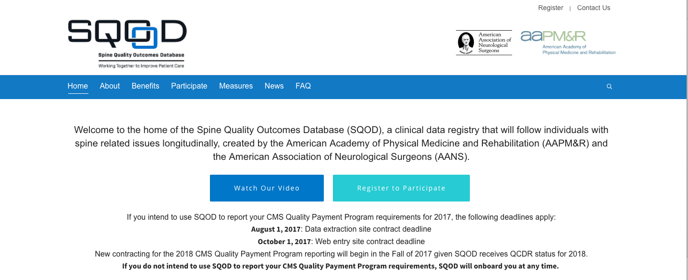
Qualified Clinical Data Registries (QCDR)
SQOD-Specific Measures
Depression and Anxiety Assessment Prior to Spine-Related Therapies
Unplanned Admission to Hospital Following Percutaneous Spine Procedure within the 30-Day Post-Procedure Period
Functional Outcome Assessment for Spine Intervention
Narcotic Pain Medicine Management Prior to and Following Spine Therapy
Complication Following Percutaneous Spine-Related Procedure
Quality-of-Life Assessment for Spine Intervention
Patient Satisfaction with Spine Care
Spine/Extremity Pain Assessment

Slide 17
AAPM&R Measures Under Development
Proposed List of Measures | Setting
Measure #1a: Assessment of Muscle Spasticity | Inpatient Rehab
Measure #1b: Assessment of Muscle Spasticity | SNF/LTC
Measure #2a: Management of Muscle Spasticity | Inpatient
Measure #2b: Management of Muscle Spasticity | Outpatient
Measure #3: Patient Reported Management of Muscle Spasticity Symptoms
Measure #4a: Pain Related to Muscle Spasticity | Inpatient
Measure #4b: Pain Related to Muscle Spasticity | Outpatient
Measure #5a: Sleep Related to Muscle Spasticity | Inpatient
Measure #5b: Sleep Related to Muscle Spasticity | Outpatient
Measure #6: Functional Assessment to Determine Rehabilitation Needs
Measure #7: Family Training | Inpatient Rehab/ SNF
Measure #8: Family Training | Acute Care
Measure #9: Post-Stroke Depression
Measure #10: Opioid Dosage

Slide 18
MIPS Final Score
Quality
ACI
IA
Final Score
60%
25%
15%
2017 Final Score | 2019 Payment Adjustment
≥ 70 points | Positive adjustment Eligible for exceptional performance bonus – minimum of additional 0.5%
4- 69 points | Positive adjustment Not eligible for exceptional performance bonus
3 points | Neutral payment adjustment
0 points | Negative payment adjustment of -4%

Slide 19
Available measures (and measure specifications can change from year to year) so you will need to revisit your reporting strategy annually
If you can report on more than 6 measures, CMS will base your Quality Performance Score on the highest scoring 6 measures
If there are few measures on which you are able to report, CMS has created a mechanism called the Eligible Measure Applicability (EMA) process to validate whether your Quality Performance Category score can be based on scoring fewer than 6 measures
Multi-specialty groups that report as a “group” can rely on measures which might not be applicable to the services you provide, so be sure to evaluate your entire group’s reporting strategy
In order to have the best possible chance at a positive payment update even in the face of measure selection difficulties, develop a reporting strategy in the Improvement Activity and Advancing Care Information Performance Categories
Takeaways

Slide 20
http://www.aapmr.org/quality-practice/macra/quality-payment-program/merit-incentive-payment-system
https://qpp.cms.gov/
AAPM&R Annual Assembly Sessions: “MIPS: Preparing your practice for reporting and strategies to improve performance”
  Friday, October 13: 4:00 pm - 5:30 pm
  Saturday, October 14: 4:00 pm – 5:30 pm
Additional Resources

Slide 21

Questions?

