Slide 1
2019 Quality Payment Program (QPP)
Merit-based Incentive Payment System (MIPS) Reporting Webinar
December 12, 2018
(This webinar is being recorded)

Slide 2
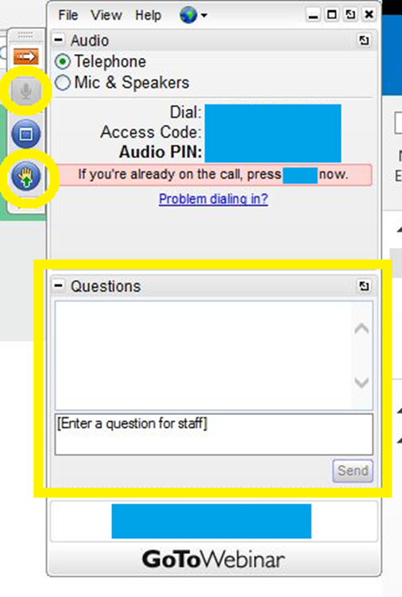
Housekeeping
Please note, your line has been muted to prevent background noise.
Ways to participate in this webinar:
  Use the “Raise Hand” feature to indicate if you’d like to join the discussion
  Use the “Questions” features to provide additional input to us
This webinar is being recorded and will be shared with those who could not attend.

Slide 3
2019 Quality Payment Program (QPP) Merit-based Incentive Payment System (MIPS) Reporting
American Academy of Physical Medicine & Rehabilitation
December 12, 2018
Cindy Moon, MPP, MPH
VP, Health Care Payment and Delivery Reform
Hart Health Strategies, Inc.

Slide 4
  Quality Payment Program (QPP)
MIPS
Provides payment adjustments based on a composite score across four categories: Quality Cost Promoting Interoperability (PI; formerly Advancing Care Information) Improvement Activities
Maximum negative adjustments growing from 4% for 2019 payment up to 9% for 2022 onward Annual payment updates of 0.25% starting in 2026
2018: ~40% of eligible clinicians
2019: slightly HIGHER
Advanced APMs
Provides a 5% lump sum incentive payment for clinicians who have significant participation in risk-based APMs that rely on certified EHR technology and MIPS-like quality measures (aka ”Advanced APMs”).
Exempt from MIPS reporting requirements and payment adjustments Annual payment updates of 0.75% starting in 2026
2018: 12-16% of eligible clinicians
2019: slightly LOWER
*Captures 65% of Medicare payments

Slide 5
MIPS Eligible Clinicians
MIPS Eligible Clinicians defined as Physicians, PAs, NPs, CNS, and CRNAs
New for 2019:
  Physical therapists
  occupational therapists
  qualified speech-language pathologists
  qualified audiologists
  clinical psychologists
  registered dieticians or nutrition professionals

Slide 6
MIPS Eligible Clinicians
Exclusions:
  Newly enrolled in Medicare
  Significantly participating in advanced APMs
  Below the low-volume threshold
    $90,000 or less in Part B allowed charges
    200 or fewer Part-B enrolled Medicare patients
    200 or fewer covered professional services under the Physician Fee Schedule (new for 2019)
New for 2019: Opportunity to opt-in if you meet one or two of the low-volume criteria, but not all three
Specialty | Newly- Enrolled | QP Status | Low-Volume | Total Exclusions | Total Inclusions
Physical Medicine (9,856) | 501 (5.1%) | 79 (0.8%) | 2,756 (28.0%) | 3,336 (33.8%) | 6,520 (66.2%)
2018 and 2019: This number will increase significantly as the threshold moved from $30,000 or 100 patients to $90,000 to 200 patients
- CMS estimates for 2017

Slide 7
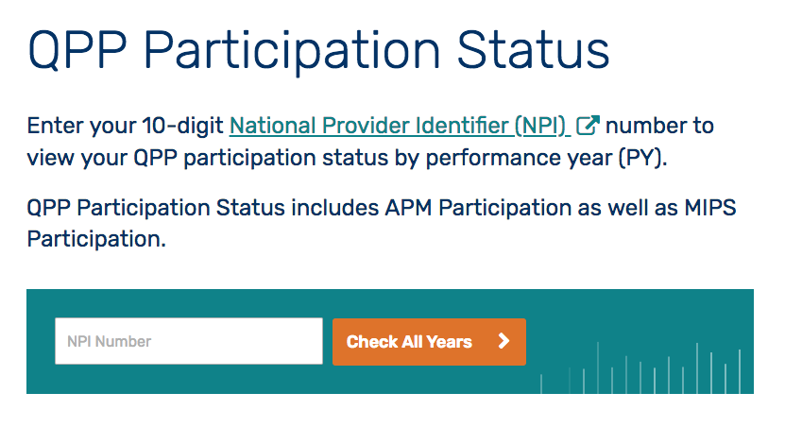
MIPS NPI Look-up: qpp.cms.gov/ participation-lookup

Slide 8
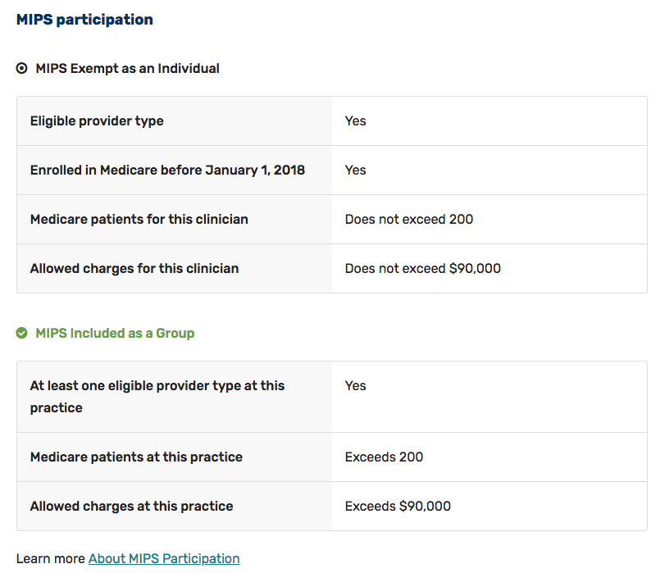
MIPS NPI Look-up

Slide 9
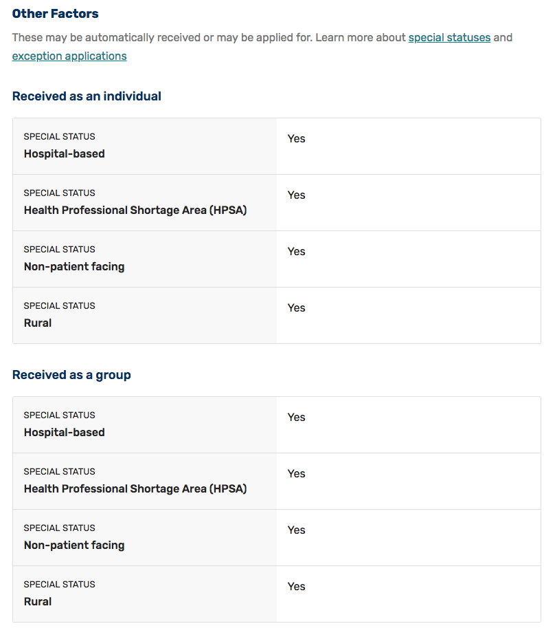
MIPS NPI Look-up

Slide 10
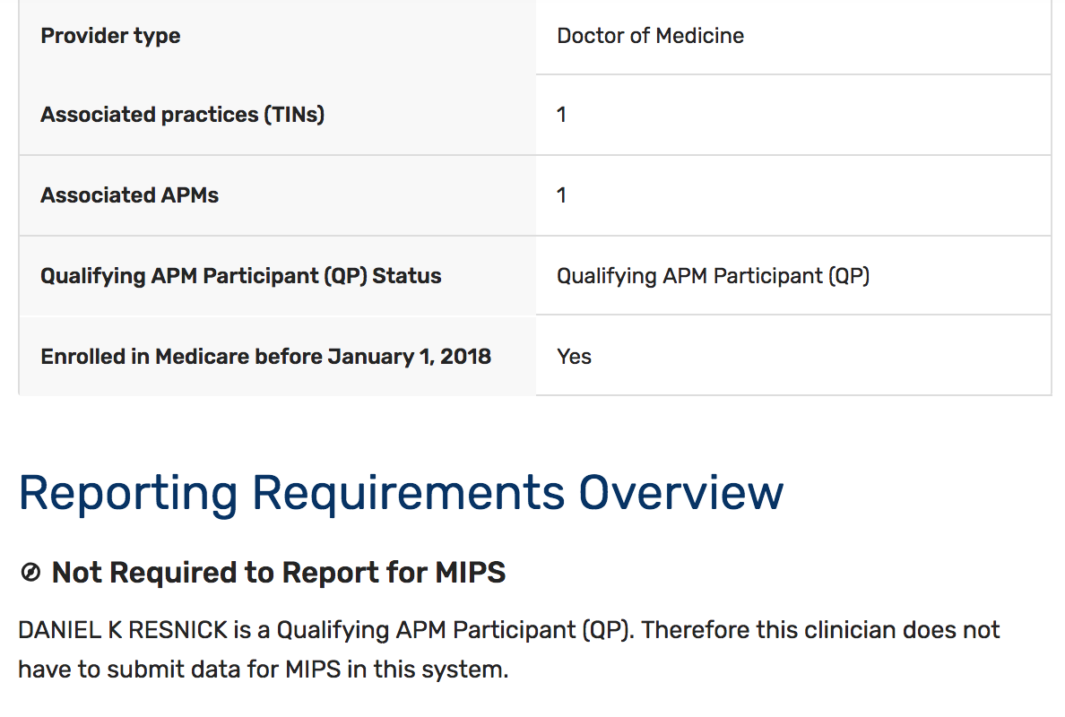
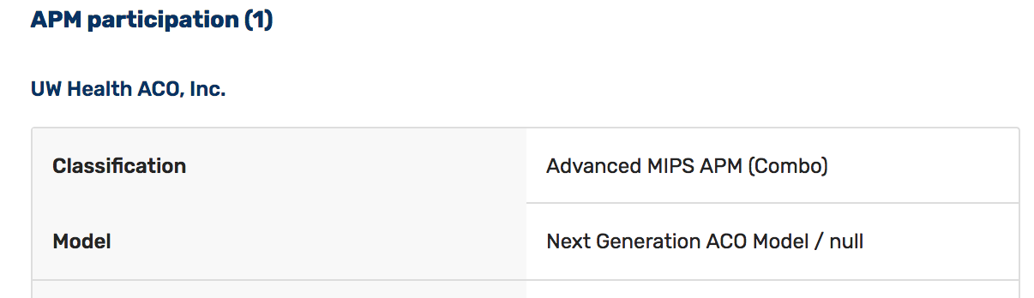
MIPS NPI Look-up

Slide 11
MIPS Overview
Performance Category | Category Weight
 | Performance Year 2017 | Performance Year 2018 | Performance Year 2019
Quality | 60% | 50% | 45%
Promoting Interoperability | 25% | 25% | 25%
Cost | 0% | 10% | 15%
Improvement Activities | 15% | 15% | 15%
Based on performance across these categories, clinicians can face negative payment adjustments of 4 percent in 2019, rising over time to 9 percent in 2022.
For 2021 payment (based on 2019 performance), a maximum negative adjustment of 7 percent applies.

Slide 12
MIPS Participation Options
Clinicians can participate in MIPS in several ways, including:
  As an individual clinician (reporting at the TIN/NPI level)
  As a group (reporting at the TIN level)
If you are part of a group:
  Check to see if your group is handling reporting on clinicians’ behalf
  Multi-specialty groups that report as a “group” can rely on measures which might not be applicable to the services you provide, so be sure to evaluate your entire group’s reporting strategy

Slide 13
MIPS Data Collection Types for Individual Clinicians
 | Claims* | Qualified Registry | Qualified Clinical Data Registry (QCDR) | Certified EHR Technology | CMS Web-based Attestation
Quality
Improvement Activities
Promoting Interoperability
Cost | Administrative claims (no submission required)
For 2019, clinicians can use different reporting mechanisms across categories and multiple mechanisms within each category.
* Limited to small practices only for 2019
** Reporting options for group reporting vary to an extent.

Slide 14
Quality Performance Category: General Requirements
 | 2019
Required Measures | 6 measures, including 1 outcome or high priority measure. If more than 6 measures are submitted, CMS will base your final score on the 6 with the highest score.
Data Completeness | Report each measure for at least 60% of applicable patients
Performance Period | Full Calendar Year
Achievement Points | 10 points per measure, compared to national benchmarks Failure to meet data completeness: 1 point Reporting on <20 patients: 3 points Reporting on measure with no benchmark: 3 points
Improvement Points | CMS will measure “improvement” at the quality category level

Slide 15
Quality Performance Category: Topped Out Measures and Bonus Points
Topped Out Measures
  7 point cap applies to measures topped out for two years (applies to 6 measures in 2018; measures in 2019 TBD)
  If a measure is topped out for at least 3 years, it could be proposed for removal in the 4th year
  CMS also finalized that it could accelerate removal of highly topped out (98-100%) measures within a year for future years
Bonus Points
  High priority measures:
    2 points for outcome and patient experience measures
    1 point for other high priority measures: Appropriate use; Patient safety; Efficiency; Care coordination; Opioid-related
    Not available for reporting via Web Interface
  End-to-end electronic reporting:
    1 point for each measure submitted using end-to-end electronic reporting
  Bonus points are available even if they are for measures that are not in the top 6 scored measures, if they meet data completeness and case minimum requirements.

Slide 16
Using PQRS Reporting Data as an Indicator of MIPS Participation
Participation % by Specialty (2016)
1. Pathology | 90.2%
2. Anesthesiology | 89.1%
3. Emergency Medicine | 86.2%
4. Radiology | 85.7%
5 Oncology/Hematology | 85.5%
6. Thoracic/Cardiac Surgery | 85.2%
7. Interventional Radiology | 85.0%
8. Cardiology | 84.6%
9. Radiation Oncology | 83.2%
10. Rheumatology (tie) | 82.9%
10. Colon/Rectal Surgery (tie) | 82.9%
All MDs/DOs | 77.0%
37. Physical Medicine | 65.2%
% Penalized by Specialty (2018)
1. Oral /Maxillofacial Surgery | 67.5%
2. General Practice | 65.0%
3. Psychiatry | 60.5%
4. Plastic Surgery | 50.3%
5. Allergy/Immunology | 41.8%
6. Physical Medicine | 39.1%
7. Obstetrics/Gynecology | 32.3%
8. Dermatology | 30.6%
9. Geriatrics | 29.7%
10. Otolaryngology | 29.6%
All MDs/DOs | 26.1%

Slide 17
Physical Medicine PQRS Reporting in 2015
Physical Medicine PQRS Reporting in 2016

Slide 18
2015
Measure Name | Outcome or High Priority?
1. Documentation of Current Medications in the Medical Record (PQRS #130) | X
2. Body Mass Index (BMI) Screening and Follow-Up (PQRS #128)
3. Tobacco Use: Screening and Cessation Intervention (PQRS #226)
4. Pain Assessment and Follow-Up (PQRS #131) | X
5. Falls: Risk Assessment (PQRS #154) | X
Top 5 Most Reported Measures in
Physical Medicine
2016
Measure Name | Outcome or High Priority?
1. Documentation of Current Medications in the Medical Record (PQRS #130) | X
2. Body Mass Index (BMI) Screening and Follow-Up (PQRS #128)
3. Tobacco Use: Screening and Cessation Intervention (PQRS #226)
4. Pain Assessment and Follow-Up (PQRS #131) | X
5. Falls: Risk Assessment (PQRS #154) | X

Slide 19
2019 MIPS Physical Medicine Specialty Measure Set
 | Measure | Reporting Option
Outcome or High Priority? |  | Claims | EHR | Registry
X | QPP #47: Advance Care Plan | X |  | X
X | QPP #109: Osteoarthritis (OA): Function and Pain Assessment | X |  | X
 | QPP #128: Preventive Care and Screening: Body Mass Index (BMI) Screening and Follow-Up Plan | X | X | X
X | QPP #130: Documentation of Current Medications in the Medical Record | X | X | X
X | QPP #131: Pain Assessment and Follow-Up | X |  | X
X | QPP#154: Falls: Risk Assessment | X |  | X
X | QPP #155: Falls: Plan of Care | X |  | X
X | QPP #182: Functional Outcome Assessment | X |  | X
 | QPP #226: Preventive Care and Screening: Tobacco Use: Screening and Cessation Intervention | X | X | X
 | QPP #317: Preventive Care and Screening: Screening for High Blood Pressure and Follow-Up Documented | X | X | X
X | QPP #374: Closing the Referral Loop: Receipt of Specialist Report |  | X | X
 | QPP #402: Tobacco Use and Help with Quitting Among Adolescents |  |  | X
X | QPP #408: Opioid Therapy Follow-up Evaluation |  |  | X
X | QPP #412: Documentation of Signed Opioid Treatment Agreement |  |  | X
X | QPP #414: Evaluation or Interview for Risk of Opioid Misuse |  |  | X
 | QPP #431: Preventive Care and Screening: Unhealthy Alcohol Use: Screening & Brief Counseling |  |  | X
X | QPP #468: Continuity of Pharmacotherapy for Opioid Use Disorder |  |  | X
Red indicates topped out status for 2018.

Slide 20
Quality Performance Category: New Measures
CMS finalized several new measures for 2019:
  Average change in functional status following lumbar spine fusion surgery (MN Community Measurement)
  Average change in functional status following lumbar discectomy laminotomy surgery (MN Community Measurement)
  Average change in leg pain following lumbar spine fusion surgery (MN Community Measurement)
  Average change in functional status following total knee replacement surgery (MN Community Measurement)
CMS also finalized a new skilled nursing facility specialty set for 2019.

Slide 21
Eligible Measure Applicability (EMA)
Process
According to CMS, the EMA is “an enhanced version of Measure-Applicability Validation (MAV) process previously used for PQRS”
Only available for Claims and Registry reporting (not EHR, Qualified Clinical Data Registries, or Web-Interface reporting)
If the EMA process finds an applicable measure was available, the missing measure is scored with a performance of zero
If process finds no applicable measure was available, the missing measures are removed from the calculation and quality performance score will be based on remaining measures. This would allow you to still potentially achieve the maximum score in the Quality Performance Category even though you are reporting fewer measures than other clinicians.

Slide 22
Cost Performance Category
In 2019, the Cost Performance Category weight is increasing to 15% based on the Medicare Spending Per Beneficiary (MSPB) Measure, the Total Per Capita Cost (TPCC) Measure, and 8 episode-based cost measures, all weighted equally.
  All measures will receive a score of 1 to 10 points, and the final cost performance category score will average performance across all applicable measures.
  If you do not qualify to be scored on any measure at all, then your cost category weight will go down to 0%.
While performance on these measures will be based on the full 2019 calendar year, there is no affirmative reporting obligation: CMS calculates measure performance based off administrative claims data.

Slide 23
Cost Performance Category: Future Measures
Future cost measures (including additional clinically-specific episode-based cost measures) are currently under development and consideration for future rulemaking.
  Lumbar spine fusion for degenerative disease, 1-3 levels
    Field tested in October
    Under consideration by the Measure Applications Partnership for potential recommendation for rulemaking for 2020

Slide 24
Promoting Interoperability (PI) Performance Category
PI Performance Category (formerly Advancing Care Information) is premised on previous EHR Meaningful Use program
For 2019, CMS revised the PI category to increase focus on interoperability and opioid management
  Streamlined set of measures
    5 mandatory measures
    2 voluntary opioid-related measures
  Performance-based scoring across all measures (separate base and performance scoring discontinued)
As previously finalized, CMS is requiring use of 2015 edition CEHRT for the 2019 performance period.
  2014 edition CEHRT is no longer allowed
Reporting is required for at least 90 consecutive days in 2019
Certain categories of clinicians (e.g. hospital-based clinicians; ASC-based clinicians) are eligible for automatic or application-based reweighting of the PI category.

Slide 25
Promoting Interoperability (PI) Performance Category
Measures | Maximum Points
E-prescribing | 10
Support Electronic Referral Loops by Sending Health information | 20
Support Electronic Referral Loops by Receiving and Incorporating Health Information (NEW) | 20
Provide Patients Electronic Access to their Health Information | 40
Report to two different public health agencies or registries for any of the following: Immunization Registry Reporting Electronic Case Reporting Public Health Registry Reporting Clinical Data Registry Reporting Syndromic Surveillance Reporting | 10
Bonus: Query of Prescription Drug Monitoring Program (PDMP) (NEW) | 5
Bonus: Verify Opioid Treatment Agreement (NEW) | 5

Slide 26
Improvement Activities Performance Category
Most physicians or groups will be responsible for sufficiently reporting up to 4 IAs to receive full credit under the IA Performance Categories (small groups and physicians in rural areas and Health Professional Shortage Areas (HPSAs) may be eligible to report on 2 IAs and receive full credit)
For those who elect to report as a Group, the group IA score can benefit from the IA participation of a single group member (i.e., the entire group need not participate in the IA for the group to get credit).
Reporting under the IA Performance Category will be attestation-based (either through Registry- or QCDR- or EHR-based reporting options or via a CMS IA Attestation Website).
  Not all registries, QCDRs, or EHRs are equipped for IA reporting so be sure to confirm with your vendor.
Individuals or groups will have to attest to engaging in the activities for at least 90 continuous days
Scoring advantages under IA Performance Category for participating in Alternative Payment Models (APMs)

Slide 27
Facility-Based Measurement
CMS finalized the availability of facility-based measurement for 2019 for the quality and cost performance categories.
Facility-based individuals and groups could be scored on MIPS cost and quality based on an attributed hospital’s performance under the Hospital Value Based Purchasing Program
  Individual:
    75% or more of covered professional services furnished in inpatient hospital (POS 21), on-campus outpatient hospital (POS 22), or emergency department settings (POS 23); AND
    At least 1 service billed in POS 21 or POS 23
  Group: At least 75 percent of NPIs in the group determined to be facility-based at the individual level
For clinicians or groups determined to be facility-based, CMS will use facility-based scoring if it results in a more favorable combined cost and quality score than data submitted via MIPS
  No active election required
Clinicians will not know their hospitals’ performance ahead of time.

Slide 28
Special Treatment of Small Practices
If you practice in a group of 15 or fewer eligible clinicians, CMS has provided several special accommodations:
  Continued availability of Part B claims based quality reporting
  Minimum score of 3 points on all quality measures (even without meeting data completeness requirements)
  Lower reporting burden under the Improvement Activities category
  Availability of a ”small practice hardship exemption” for the Promoting Interoperability category
    Note that this exemption is not automatic or guaranteed
  A small practice bonus of 6 points added to the numerator of the quality performance category

Slide 29
Final Scoring
Reminder: MIPS is not ”all or nothing” like previous programs; in general, extra effort can help you move up the scoring ladder
Final scores will add together performance across each category, adjusted for the weight of each category.
  If CMS cannot score certain categories (e.g. the cost or PI category), then CMS will increase the weight of other categories (usually the quality category).
CMS will add a “complex patient bonus” to the MIPS final score that is intended to account for the relative complexity of each clinician’s patient population (subject to a cap of 5 points).

Slide 30
2019 MIPS Final Score
2019 Final Score | 2021 Payment Adjustment
75 – 100 points | Positive adjustment Eligible for exceptional performance bonus
30.01 – 74.99 points | Positive adjustment Not eligible for exceptional performance bonus
30 points | Neutral payment adjustment
7.51-29.99 | Negative adjustment > -7% and < 0%
0 – 7.5 points | Negative payment adjustment of -7%

Slide 31
2017 Performance Year Data
93 percent of MIPS eligible clinicians qualified for a positive payment adjustment
  71 percent qualified for exceptional performance bonus
  Maximum upward payment adjustment: 1.88 percent
Overall national mean score: 74.01 points
Overall national median score: 88.97 points
Lower performance for small practices (mean of 43.46) and rural practices (mean of 63.08)
Individual performance results for 2017 are available on qpp.cms.gov with the same EIDM credentials used to submit/view data during the submission period

Slide 32
2018 Estimates for Payment Adjustments
Specialty | Positive or Neutral | Exceptional Performance Bonus | Negative
Physical Medicine (5,434) | 93.2% | 61.1% | 6.8%

Slide 33
Reminders and Outlook
REMINDER: 2018 data submission runs through March 31, 2019.
  Performance in 2018 affects payment in 2020, subject to a maximum negative adjustment of 5 percent
  A MIPS final score of 15 points is needed to avoid a penalty for 2018 performance/2020 payment
OUTLOOK: Despite criticisms, MIPS is not likely going away in the near future, and most clinicians will be required to participate in MIPS due to a lack of relevant APMs.
OUTLOOK: For future years, CMS is required to continue increasing the performance threshold until it reaches mean or median performance.
OUTLOOK: CMS will continue to cap or remove topped-out measures and other “low value” measures. Clinicians and groups should take this into consideration when developing a long-term reporting strategy.

Slide 34
AAPM&R Resources and Assistance

Slide 35
Estimated 2019/2021 Penalties and Risks
 | Median Net Professional Collections | 33.2% Payor Mix | 7% Penalty on 2021 Payment (based on 2019 score)
Average Overall | $530,331.00 | $176,069.89 | $12,324.89
Central Nervous System | $411,397.00 | $132,583.80 | $9,280.87
Musculoskeletal Medicine | $532,791.00 | $176,886.61 | $12,382.06
Pain Medicine/Neuromuscular | $711,111.00 | $236,088.85 | $16,526.21
General and Medical Rehabilitation | $491,000.00 | $163,012.00 | $11,410.84
*data is from 2017 AAPM&R Compensation Survey
Notes:
Hatzakis

Slide 36
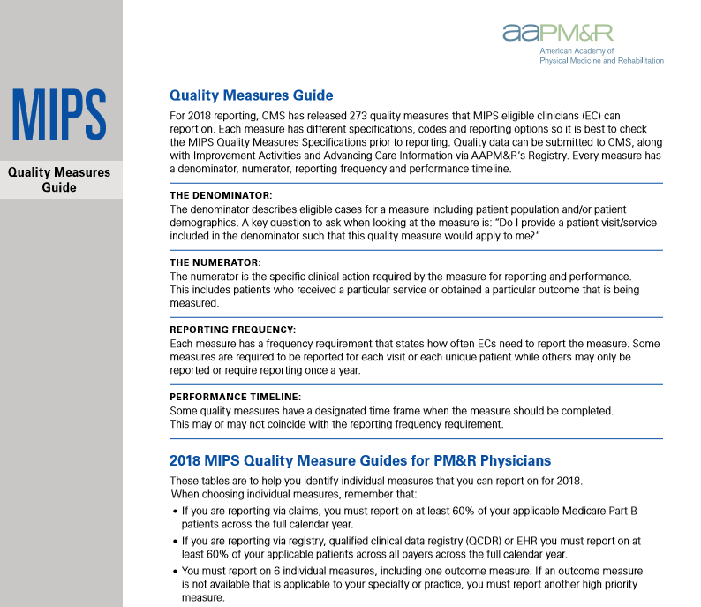
MIPS Resources
AAPM&R’s Website
  https://www.aapmr.org/mips
  Look for our QPP Guides
Upcoming The Physiatrist articles
Annual Assembly education

Slide 37
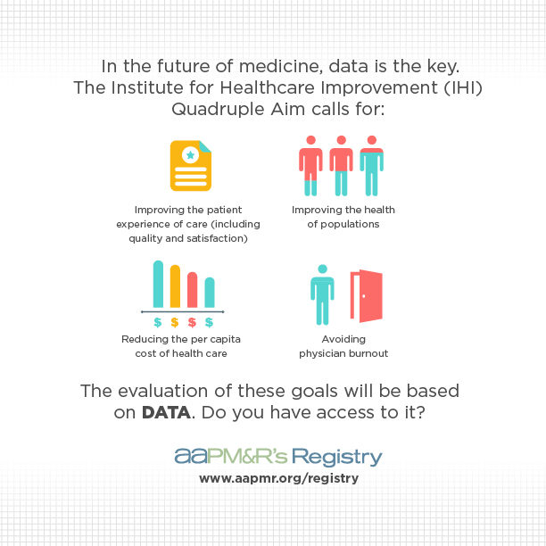
AAPM&R’s Registry

Slide 38

Benefits of Participating
For YOU
One place to meet your requirements (MIPS, MOC® Part IV)
See trends in YOUR data against your peers
Show your commitment to improving patient care to your institution, payors and others
For YOUR Institution
Benchmarking data against other institutions
Drive quality metrics for physiatry
Provide data for payor negotiations
For YOUR Specialty
Quantify and prove the value of PM&R
Conduct specialty-wide QI initiatives
Determine standards for practicing physiatry
Notes:
Hatzakis

Slide 39
AAPM&R Registry 2019 Measures
• Functional Outcome Assessment for Spine Intervention
• Quality of Life Assessment for Spine Intervention
• Patient Satisfaction with Spine Care
• Depression and Anxiety Assessment Prior to Spine Related Therapies
• Narcotic Pain Medicine Management Prior to and Following Spine Therapy
• Complications Following Percutaneous Spine Related Procedure
• Unplanned Admission to Hospital Following Percutaneous Spine Procedure within the 30-Day Post-Procedure Period
• Spine/Extremity Pain Assessment
• Assessment and Management of Muscle Spasticity – Inpatient Setting
• Management of Muscle Spasticity – Outpatient
• Post-Acute Brain Injury: Depression Screening and Follow-Up Plan of Care
• Family Training – Inpatient Rehabilitation/Skilled Nursing Facility – Discharged to Home
• Functional Assessment to Determine Rehabilitation Needs
Notes:
Hatzakis

Slide 40

How Our Registry Stacks Up
 | AAPM&R | NASS | AANS
EHR Extraction | ✓
Send files from EHR to Registry | ✓
Web Entry | ✓ | ✓ | ✓
Can PM&R participate? | ✓ | ✓
Can non-members participate? | ✓ | ✓
Cost* | $295 up to $500/year per participant | $3,000+ | $10,000+
*Cost for NASS and AANS are site and individual specific

Slide 41
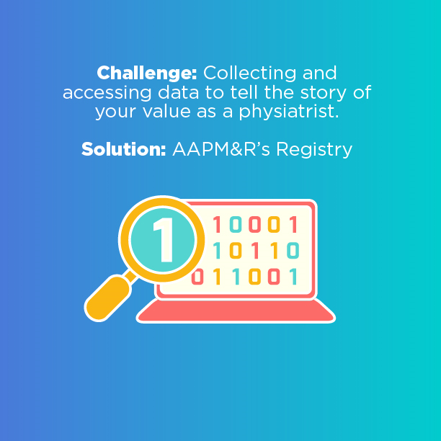
How to Get Involved
Visit Our Website
https://aapmr.org/registry
Fill out an Interest Form
https://registry.aapmr.org/InterestForm/InterestForm.aspx
Contact Us
registry@aapmr.org
Notes:
Hatzakis

Slide 42

QUESTIONS?
To ask a question, please type your question into the question box or chat box on the right

